Slide 1
Proof of concept of requirement traceability from specification to verification using a traffic light controller
Smriti Sharma

Slide 2
Agenda
1.
Objective
5.
Proposed structure
2.
Introduction
6.
Traceability
3.
Existing Methods
7.
What can be the solution?
4.
Problems associated with Existing Methods

Slide 3
Objective
Implement the whole traceability flow in order to :
Understand the current flow
Show full implementation according to the V-curve
Highlights some features which could be beneficial to add in the current flow

Slide 4
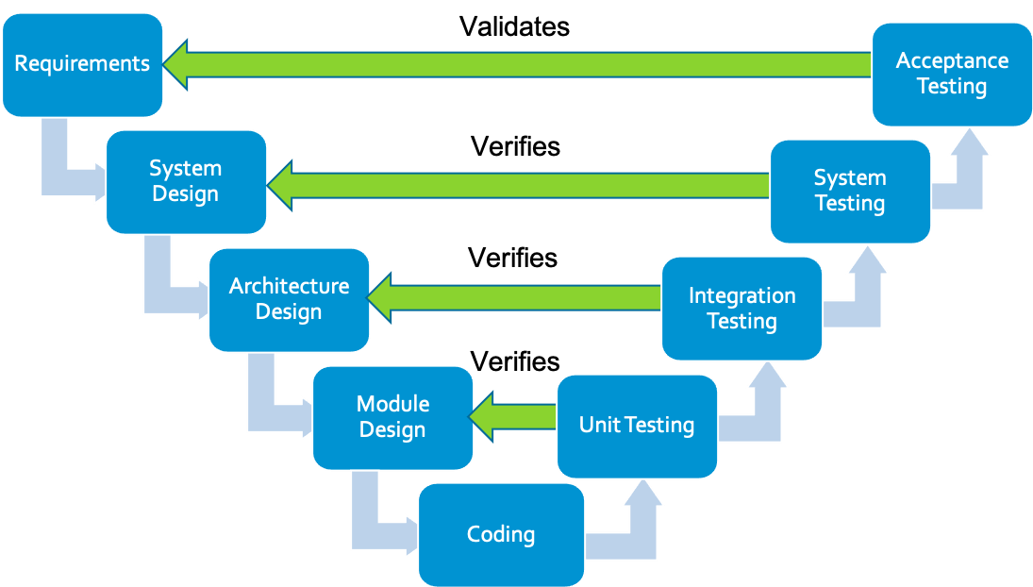
V curve Reference model
Left Side: Development
Requirements: Capture what's needed.
Design: Plan system structure.
Module Design: Detail components.
Bottom: Implementation
Coding: Build the system.
Right Side: Testing
Unit Test: Verify parts.
Integration Test: Check connections.
System Test: Validate whole system.
Acceptance Test: Confirm user fit.
Top: Maintenance
Support: Update and optimize

Slide 5
Section 1 INTRODUCTION :
What is requirement Traceability?
What is the importance ?
Role of Requirement Management in Traceability

Slide 6
What is Requirement Traceability?
Definition and Importance
Requirement traceability is the ability to describe and follow the life of a requirement, in both a forwards and backwards direction, from its origins, through its development and specification, to its subsequent deployment and use.
Purpose of Traceability
It ensures that all requirements are:
properly addressed,
implemented, and
tested, and
it enables multi-disciplinary teams involved in product definition, design, risk evaluation, and verification to relate work items from different stages of development.

Slide 7
Importance of Requirement Traceability
Compliance and Consistency
It ensures completeness and consistency with the desired specification, and it helps project teams track the implementation and testing of requirements.
Necessary to meet Quality Standards and also prove compliance to ISO processes.
Verification and Validation Testing
It enables verification and validation testing to prove the implementation of the requirements and ensures that all requirements defined for a system are tested in the test protocols.

Slide 8
The Role of Requirement Traceability in Project Management
Optimize Systems Engineering Process
Reduce our customer’s time to market
Ease the path to functional safety compliance
Reduce Non-Value Time spent on administrative tasks
Fewer Defects, discovered early
Reduce Rework late in engineering cycle

Slide 9
Section 2 :Existing Methods
Problems we are facing in the Existing flow

Slide 10
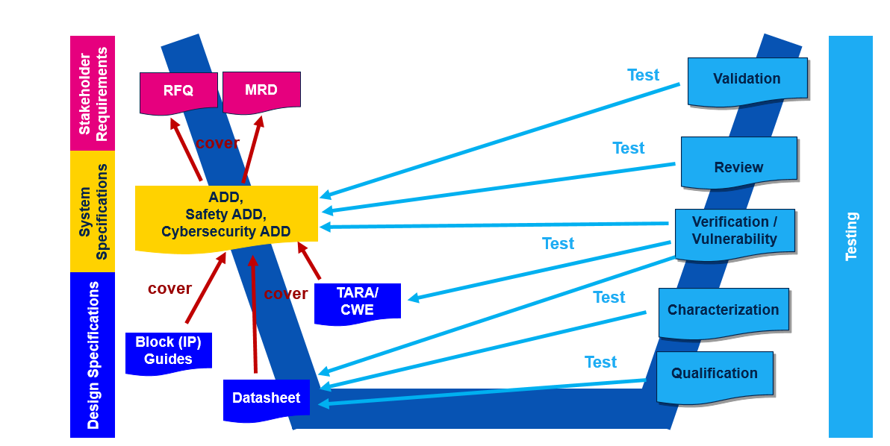
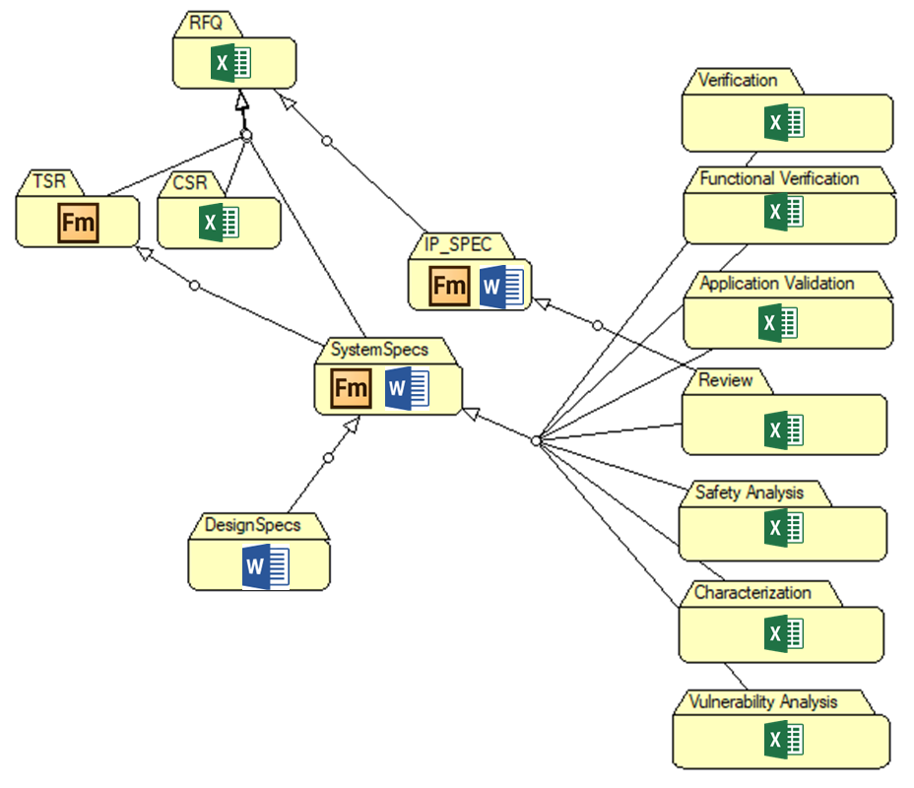
Methods and flow used currently for some projects :
Documents to be released to customers: ADD and Datasheet → 100% of traceability coverage proof is needed
Block Guides and Datasheet linked to the ADD as additional info to complete the specification of ADD requirements
As consequence of previous statements: DS parameters to be covered by ADD or with direct tests (e.g. test program, validation, characterization

Slide 11
Problems faced in the current flow
Multiple platforms are used to track the requirements
From Excel, FrameMaker, doc etc.
Difficulty in Tracking Changes as the information is fragmented
Collaboration and communication barrier
Design tags are missing
The verification team must manually examine the RTL (Register Transfer Level) code , as tags would otherwise provide straightforward access to the sections of code affecting the feature.
Without tags, there is an increased risk of adding redundant or unnecessary code to the design.
Architects find it challenging to confirm whether the implementation meets the intended requirements due to the absence of tags.
Code reuse becomes more complicated, as tags facilitate the exportation of requirements from one project to another for similar features or functions.

Slide 12
P
Scattered Format: Requirements from marketing are received in a scattered manner, lacking a centralized and coherent structure.
Multiple Channels: Information is delivered through various channels, including emails and Excel spreadsheets, leading to potential miscommunication.
Traceability Issues: The current system does not support effective traceability, making it difficult to track requirement changes and their origins.
Inefficiency: The lack of a standardized process leads to inefficiencies in organizing and understanding requirements.
Proposed Solution: Implement a unified requirements management tool to ensure all requirements are captured in a structured and traceable manner.

Slide 13
Continue..
Change Management: Without a centralized system, managing and tracking changes to requirements becomes cumbersome and error-prone.
Notification Deficit: Team members may not be promptly notified of changes, leading to outdated information guiding their work.
Version Control: Identifying the most current version of a requirement is challenging when changes are made across disparate platforms.
Impact Analysis: Assessing the impact of requirement changes on existing work is difficult without a clear history of modifications.
Proposed Solution: Establish a robust change management protocol within the requirements management tool to automatically track revisions and notify relevant stakeholders.

Slide 14
Section 3:Proposed Structure
Implementation of a Traffic light controller

Slide 15
Implementing Requirement Traceability for a Traffic light controller
It needs
Traffic Light Controller Market Specifications (MRD)
System Specification (ADD)
RTL Coding
Verification plan

Slide 16
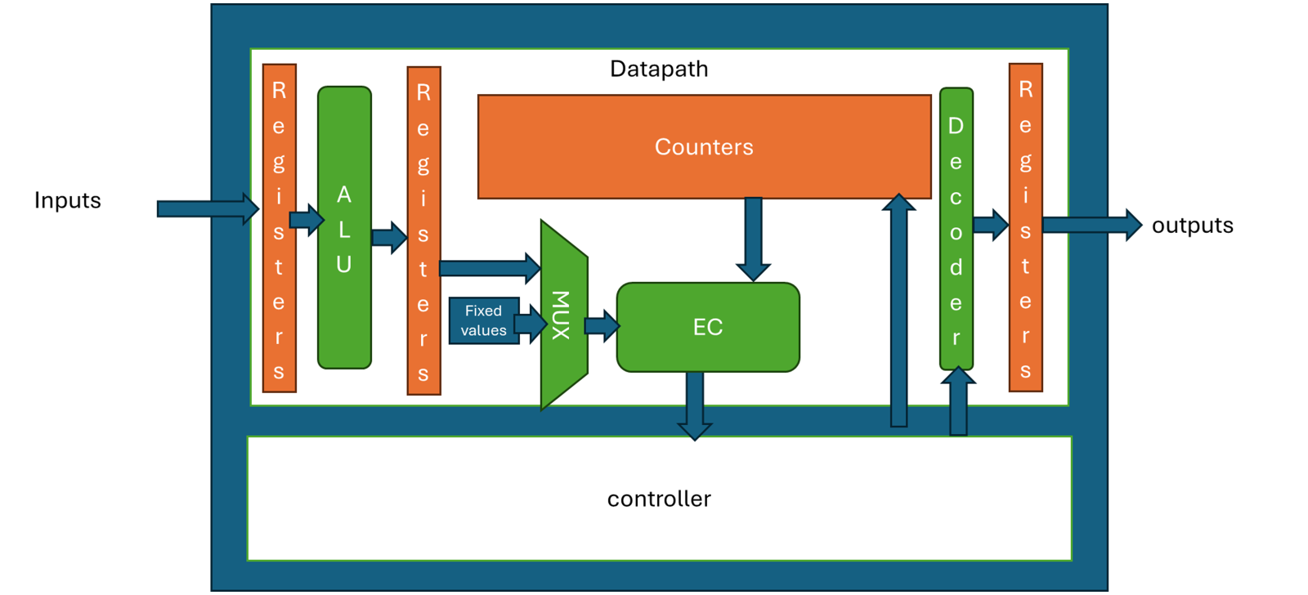
Approach for the system design

Slide 17
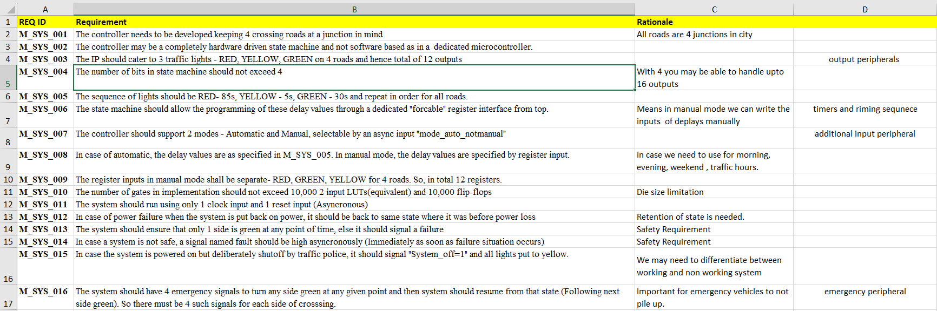
Marketing Requirements
Marketing tags that are required for traceability
Rationale is all about why we need this requirement
Detailed Description of requirements

Slide 18
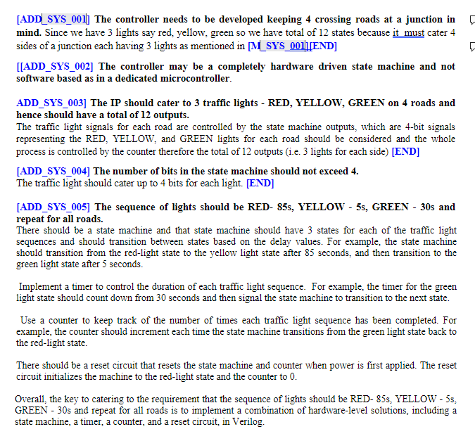
System Requirement
ADD tags corresponding to every marketing requirement always ended with keyword END
Examples of writing the requirements
Detailed system requirements

Slide 19
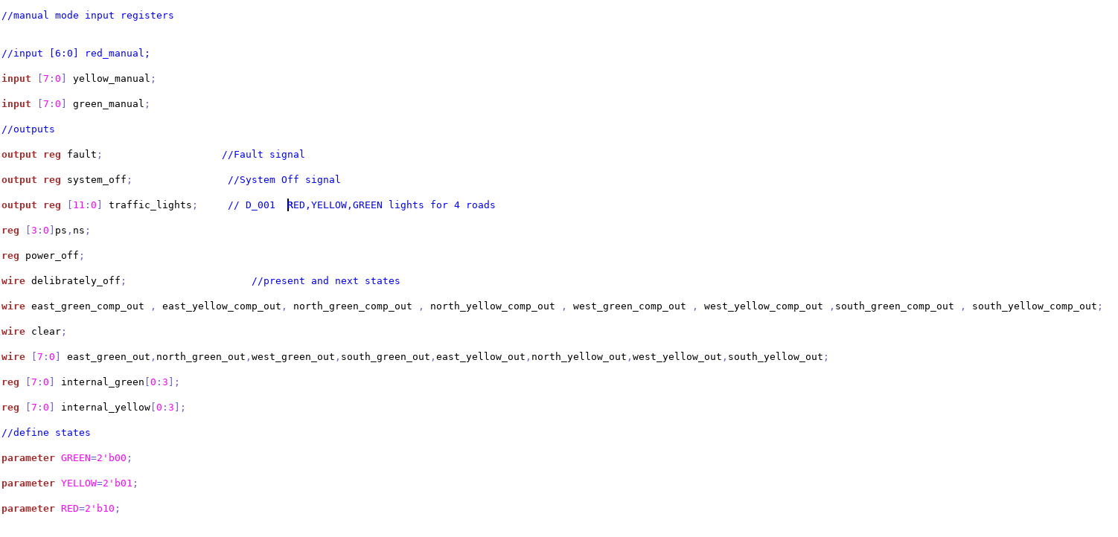
RTL Design tags
Design tag for a requirement

Slide 20
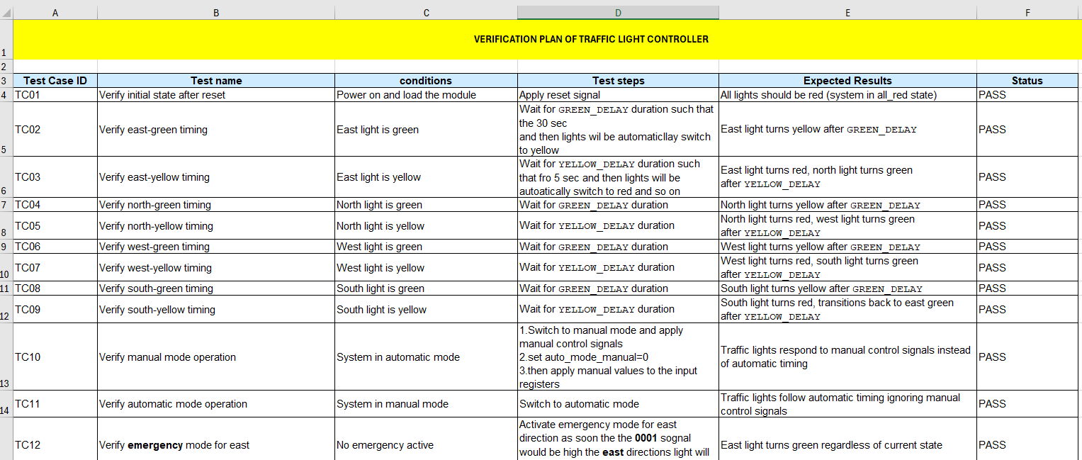
Verification plan
A unique identifier for each requirement that needs to be verified
What we did to test the requirement
The results we are expecting
A detailed description of the feature or requirement.
The current status of the verification effort (e.g., Not Started, In Progress, Blocked, Completed).

Slide 21
Verification plan
A unique identifier for each requirement that needs to be verified
What we did to test the requirement
The results we are expecting
A detailed description of the feature or requirement.
The current status of the verification effort (e.g., Not Started, In Progress, Blocked, Completed).

Slide 22
Section 4
Traceability

Slide 23
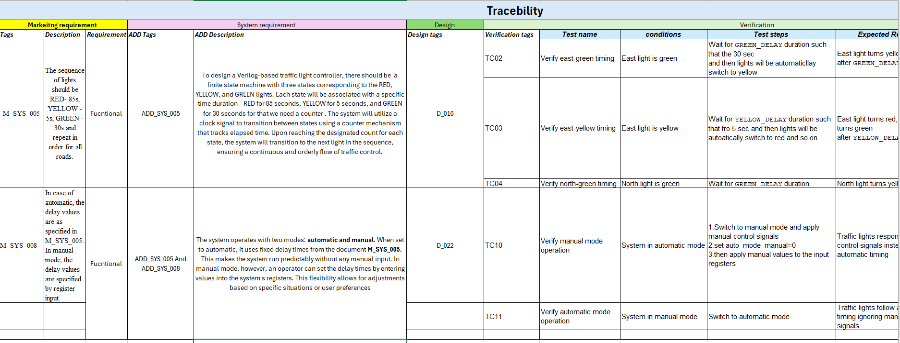
Traceability

Slide 24
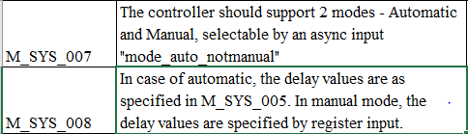
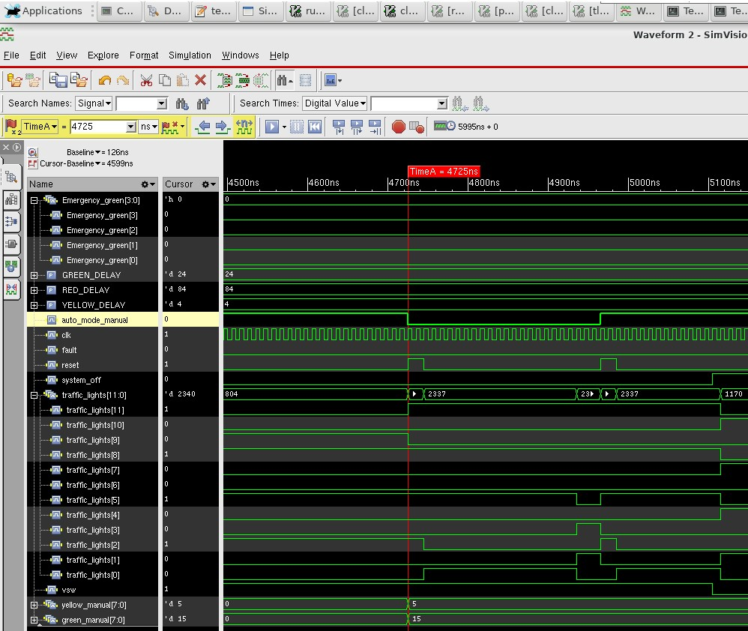
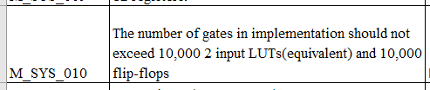
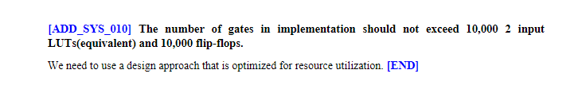
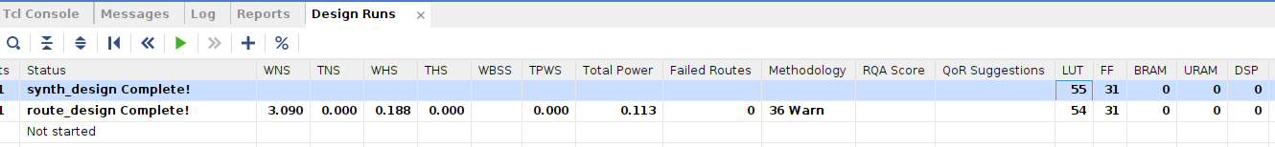
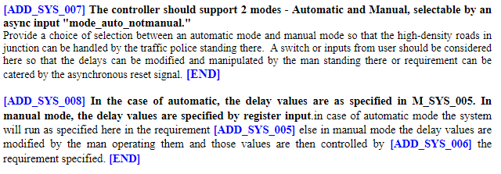
Traceability V curve verification
MRD/STAKEHOLDER REQUIREMENTS
VERIFICATION
SYSTEM REQUIREMENTS
DESIGN REQUIREMENTS
Bottom of the v is implementation ,the design

Slide 25
CAN JAMA BE THE SOLUTION?

Slide 26
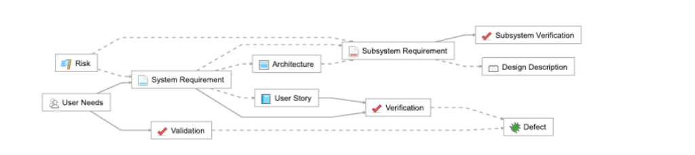
JAMA TRACEABILITY :
The following diagram is a typical relationship model in Jama Connect that adheres to a Systems Engineering Methodology (SEM).
In it, a box represents a single item type, and lines represent relationships
BENEFITS OF ESTABLISHING RELATIONSHIPS
Allocation .
Traceability.
Verification

Slide 27
Traceability from Requirements to Test
Traceability shows the relationship between items that depend upon and define each other. You can travel upstream or downstream to get more context and trace product definition from high-level requirements all the way through to final tests.
Relationships in Jama Connect are established between discrete items. For example, Stakeholder Requirement A is related to System Requirement X.
BENEFITS OF ESTABLISHING RELATIONSHIPS
Why are relationships important in Jama Connect?
Allocation — Understand which systems and subsystems implement the requirements.
Traceability — Break down high-level requirements into more detailed specifications.
Verification — Improve implementation and quality by linking requirements to tests and their results.
Impact analysis — When requirements change, identify and understand the ripple effect to lower-level requirements and testing

Slide 28
JAMA
Does Jama have that feature of triggering the changes done during the project?
How do we know that the tags are correct?
Implementation is not visible to non designers?

